Slide 1
INTERNET CENSORSHIP

Slide 2
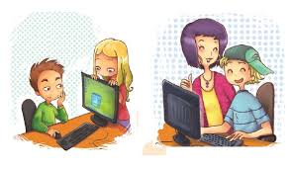
Why is important online safety?
First would be the fact that the Internet is a part of childrens life since young ages and how they relate online depends of the advice they had from the adults.

Slide 3
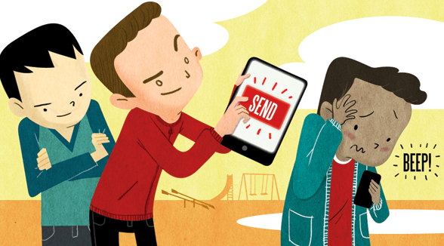
Cyberbullying
Cyberbullying or cyberharassment is a form of bullying or harassment using electronic forms of contact. Cyberbullying has become increasingly common, especially among teenagers.
Cyberbullying involves repeated behavior with intent to harm.
Cyberbullying is perpetrated through harassment, ciberstalking, denigration (sending or posting cruel rumors and falsehoods to damage reputation and friendships), impersonation, and exclusion (intentionally and cruelly excluding someone from an online group).

Slide 4
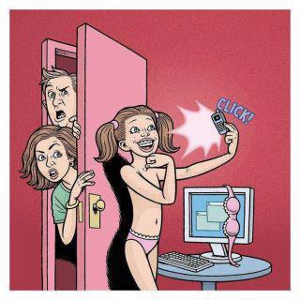
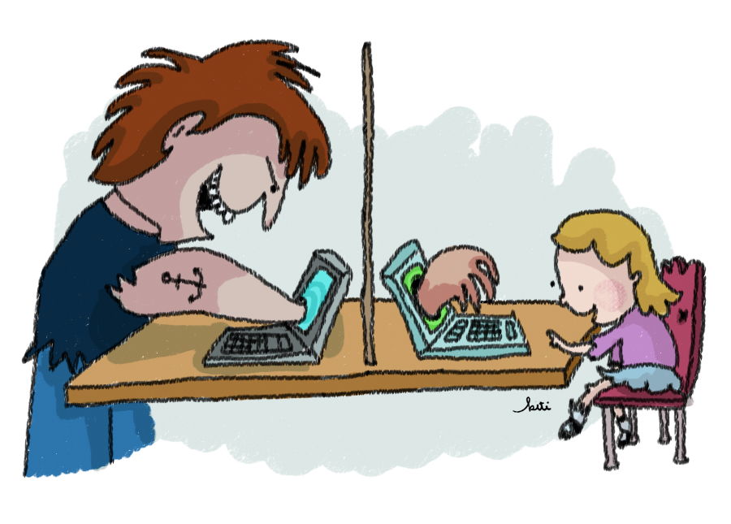
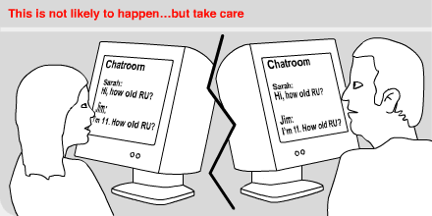
Grooming
Child grooming is befriending and establishing an emotional connection with a child, and sometimes the family, to lower the child's inhibitions for child sexual abuse. It lures minors into trafficking of children, illicit businesses such as child prostitution, or the production of child pornography.
Sexual grooming of children over the internet is most prevalent (99% of cases) amongst the 13–17 age group, particularly 13–14 year old children (48%). The majority of them are girls. The majority of the victimization occurs with mobile phone support. Children and teenagers with behavioral issues such as "high attention seeking" have a much higher risk than others.

Slide 5
Hacking
A security hacker is someone who seeks to breach defenses and exploit weaknesses in a computer system or network. Hackers may be motivated by a multitude of reasons, such as profit, protest, challenge, recreation, or to evaluate system weaknesses to assist in formulating defenses against potential hackers. The subculture that has evolved around hackers is often referred to as the computer underground.
In computer security, a hacker is someone who focuses on security mechanisms of computer and network systems. While including those who endeavor to strengthen such mechanisms, it is more often used by the mass media and popular culture to refer to those who seek access despite these security measures.

Slide 6
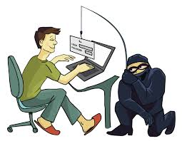
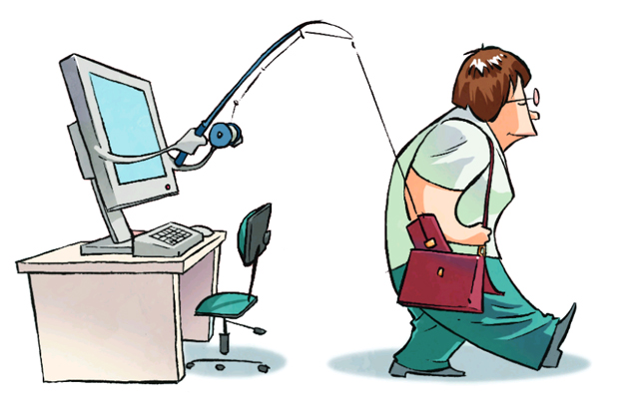
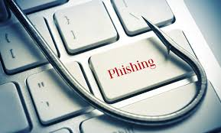
Phsihing
Phishing is the attempt to obtain sensitive information such as usernames, passwords, and credit card details (and, indirectly, money), often for malicious reasons, by disguising as a trustworthy entity in an electronic communication. The word is a neologism created as a homophone of fishing due to the similarity of using a bait in an attempt to catch a victim. According to the 3rd Microsoft Computing Safer Index Report released in February 2014, the annual worldwide impact of phishing could be as high as $5 billion.

Slide 7
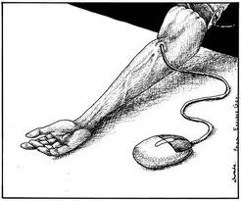
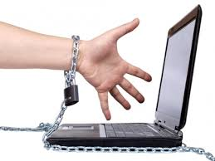
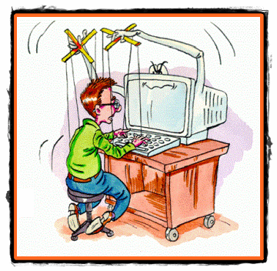
Computer addiction
Computer addiction can be described as the excessive or compulsive use of the computer which persists despite serious negative consequences for personal, social, or occupational function. Another clear conceptualization is made by Block, who stated that "Conceptually, the diagnosis is a compulsive-impulsive spectrum disorder that involves online and/or offline computer usage and consists of at least three subtypes: excessive gaming, sexual preoccupations, and e-mail/text messaging".

Slide 8
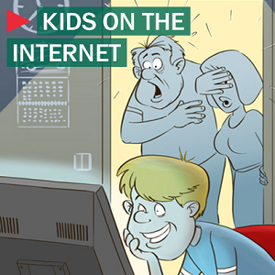
Inappropiate content
Content-control software is software designed to restrict or control the content a reader is authorised to access, especially when utilised to restrict material delivered over the Internet via the Web, e-mail, or other means.
Content-control software determines what content will be available or be blocked.
Internet service providers (ISPs) that block material containing pornography, or controversial religious, political, or news-related content en route are often utilised by parents who do not permit their children to access content not conforming to their personal beliefs. Content filtering software can, however, also be used to block malware and other content that is or contains hostile, intrusive, or annoying material including adware, spam, computer viruses, worms, trojan horses, and spyware.

Slide 9
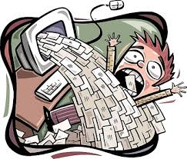
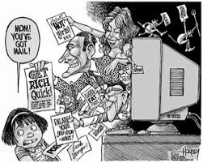
Spamming
Electronic spamming is the use of electronic messaging systems to send an unsolicited message (spam), especially advertising, as well as sending messages repeatedly on the same site. While the most widely recognized form of spam is email spam, the term is applied to similar abuses in other media: instant messaging spam, Usenet newsgroup spam, Web search engine spam, spam in blogs, wiki spam, online classified ads spam, mobile phone messaging spam, Internet forum spam, junk fax transmissions, social spam, spam mobile apps, television advertising and file sharing spam.

Slide 10
Piracy
Piracy is an act of robbery or criminal violence by ship- or boat-borne attackers upon another ship or a coastal area, typically with the goal of stealing cargo and other valuable items or properties. Those who engage in acts of piracy are called pirates.

