Slide 1
INS ANTONI CUMELLA
Granollers

Slide 2
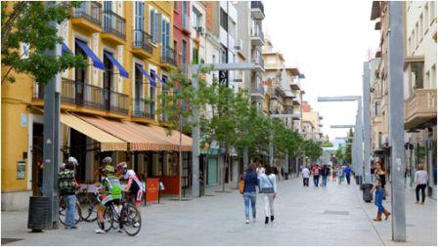
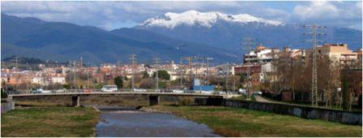
OUR CITY
Granollers is a city near Barcelona, in Catalonia. It is the capital a city of the Vallès Oriental region.
Granollers is now a bustling business centre. The city is crossed by the Congost river. It is considered to be situated in the second crown of Barcelona metropolitan area. It is around 25 km north-east of the centre of Barcelona.

Slide 3
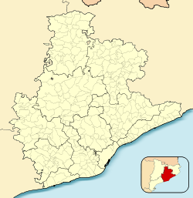
SOME NUMBERS
The population of the city is 59,930 inhabitans .
The total area is 14.9 km2.
The elevation above the sea is of 145 m.

Slide 4
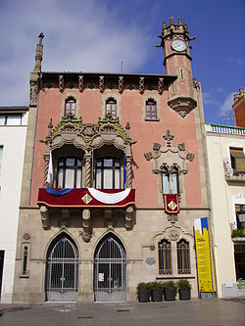
TOWN HALL
The Town Hall of Granollers is situated in front of La Porxada.
It is an ecclectic building which was built between 1902 and 1904.
The mayor of Granollers is Josep Mayoral.

Slide 5
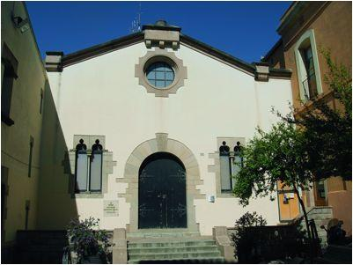
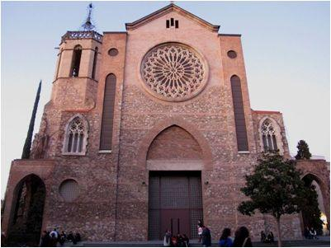
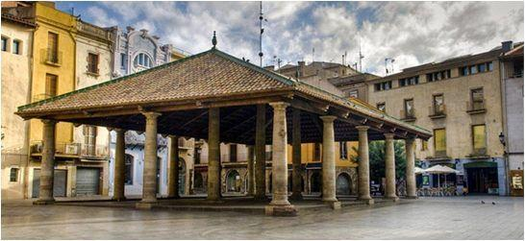
LANDMARKS OF THE CITY
La Porxada, a Renaissance building which served as a grain storehouse, is an emblematic building.
On Corró street, there is the ancient hospital of Sant Domènec, now the Francesc Tarafa theatre, a good example of restored Gothic architecture.
The church of Sant Esteve in the city centre, also contains Gothic elements from the 15th Century along with an octagonal tower.

Slide 6
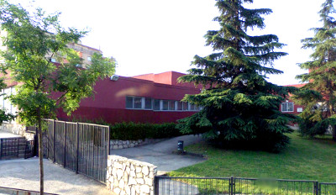
our high school
INS Antoni Cumella is a state school which was inaugurated in 1968. Its main objective is to educate students in an integrating way, from an academic as well as from a human point of view.

Slide 7
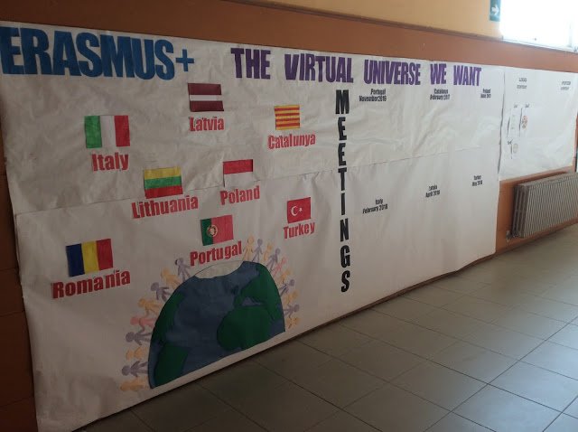
studies and projects
In our high school we teach the four courses of ESO (compulsory secondary studies) and the two courses of Batxillerat (non-compulsory studies)
We have several important projects:
GEP: we teach non-linguistic subjects in English.
French: we teach French as a second language.
Erasmus +: we are paricipating in a project together with seven European countries.

