Slide 1
POBIEDZISKA
Our beautiful town

Slide 2
Where is Pobiedziska?

Slide 3
Location
Pobiedziska lies between Poznan and Gniezno, near Ostrów Lednicki.
Pobiedziska is situated on an important trade route and it saw the birth of the Polish state.

Slide 4
The beginnings of our TOWN
Casimir the Restorer gave the name to out town in 1048. This name derived from the word "Pobieda ‘'(Victory), after he won the battle of Maslaw around the city. Pobiedziska started to develop.

Slide 5
Monuments in Pobiedziska
In this beautiful, small town there are a lot of important monuments.
These are:

Slide 6
Pobiedziska’s market Square

Slide 7
CHurch st. Michała Archanioła

Slide 8
monastery sacre coeur

Slide 9
Railway station

Slide 10
School

Slide 11
School in Pobiedziska
School in Pobiedziska was built in 1999. The school consists of four buildings. Each of them has it’s own separate story.

Slide 12
building for the second and third classes

Slide 13
Primary school’s building

Slide 14
Grammar school

Slide 15
Sport’s hall and schoolyard

Slide 16
Interesting Places in Pobiedziska

Slide 17
Miniature park

Slide 18
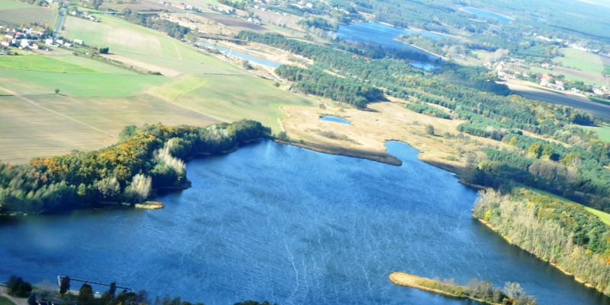
lakes around pobiedziska
In the municipality of Pobiedziska there are 8 lakes.

Slide 19
Library in pobiedziska

Slide 20
The end
Thanks for watching this presentation ☺

