Slide 1
SARNO
Presentation of the city

Slide 2
Castle of sarno
The city of Sarno comes from a Lombard castle built by the Duke of Benevento in the eighth century, and it is the first steward, then the county and finally duchy...

Slide 3
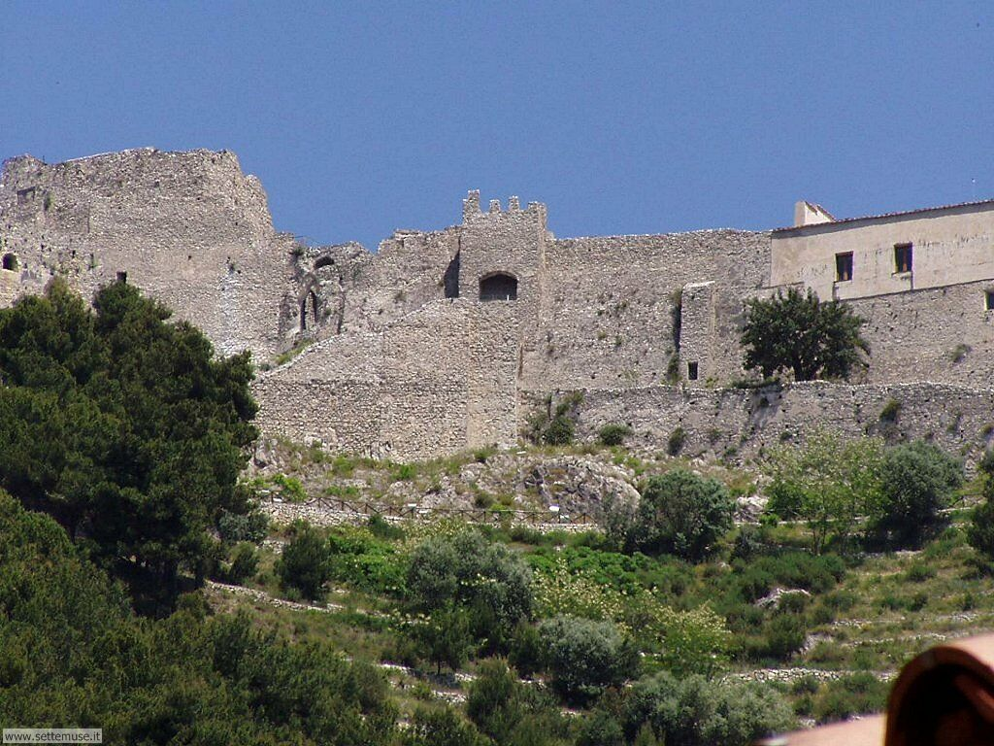
...The municipality, however, has traces of settlements from the Neolithic to the Roman period, probably abandoned after the disastrous eruption of Vesuvius that destroyed Pompei in AD 79.

Slide 4
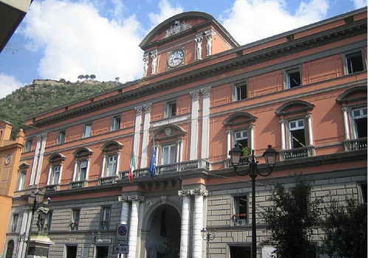
City Hall of Sarno
Sarno is an Italian town of 31,463 inhabitants in the province of Salerno in Campania

Slide 5
Borgo San Matteo
On the lower slopes of Mount Saretto. Below the castle a village was born, now known as "Borgo San Matteo", which formed the nucleus of the city of Sarno. The city adopted as its patron Saint Michael the Archangel, patron of the Lombards.

Slide 6
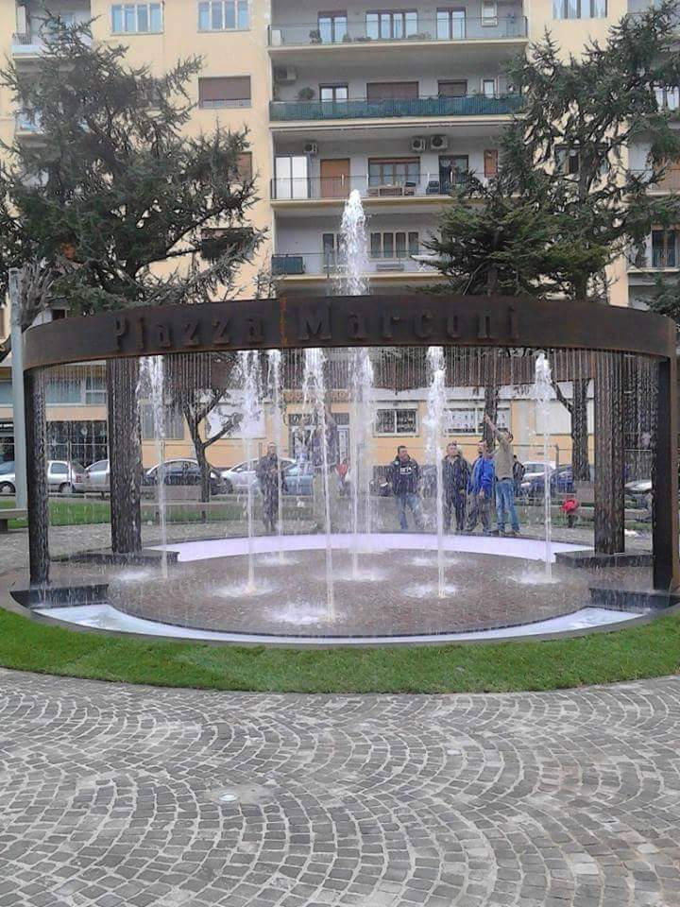
Piazza Marconi
Piazza Marconi is the most popular square in Sarno

Slide 7
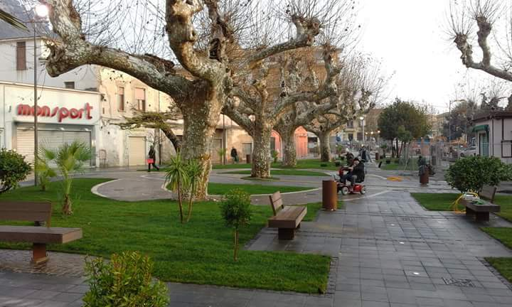

Slide 8
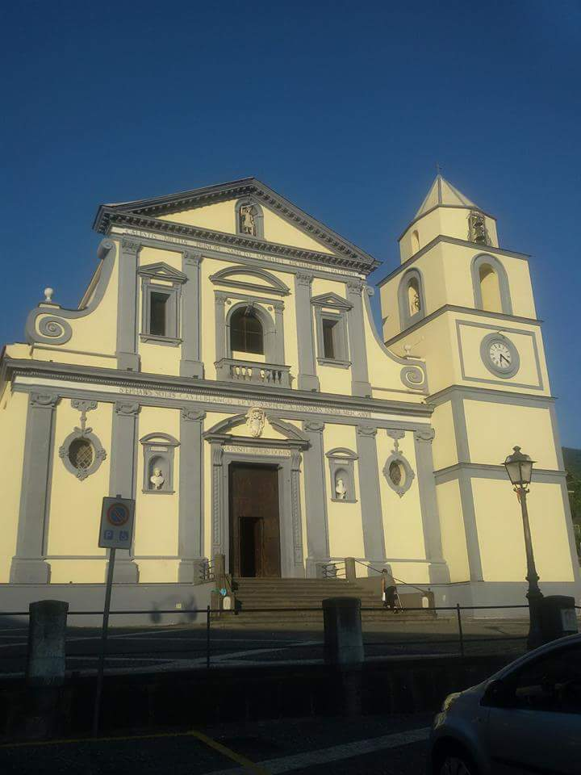
Duomo di Sarno
Sarno bishopric dates back to 1066 and the ancient cathedral, in Romanesque style, built in the local Bishop, remained in force until its complete rebuilding from the ground up in the seventeenth century, at the hands of the local bishop Stefano Sun Castelblanco. Inaugurated in 1627 it suffered extensive damage due to the eruption of Vesuvius in 1631: since then there were many restorations which it was subjected. It must be taken in particular mention the intervention of Bishop Nicola Antonio de Tura that, in the mid-seventeenth century, completed the interior furnishings enriching the church with the coffered ceiling decorations and the presbytery. As for the ancient Romanesque building with three naves, we can see only the bell tower, on the right of the facade
.

Slide 9
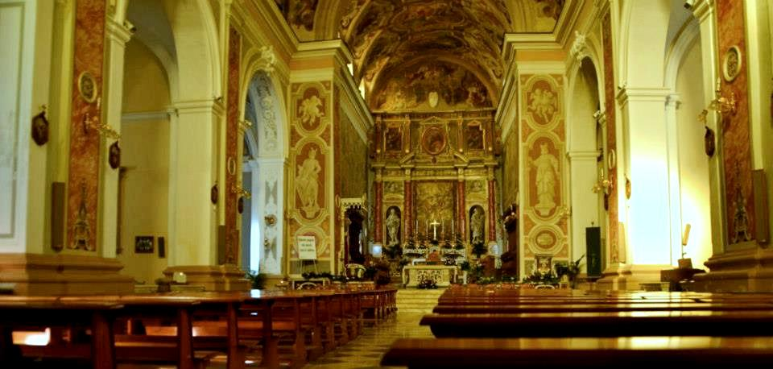
The façade, made of tuff stone, dates back to the late Renaissance style. In the gable at the top of the facade there is a statue of St. Michael the Archangel with his sword drawn, while in two niches on either side of the portal there are the busts of the holy Apostles Peter and Paul.

Slide 10
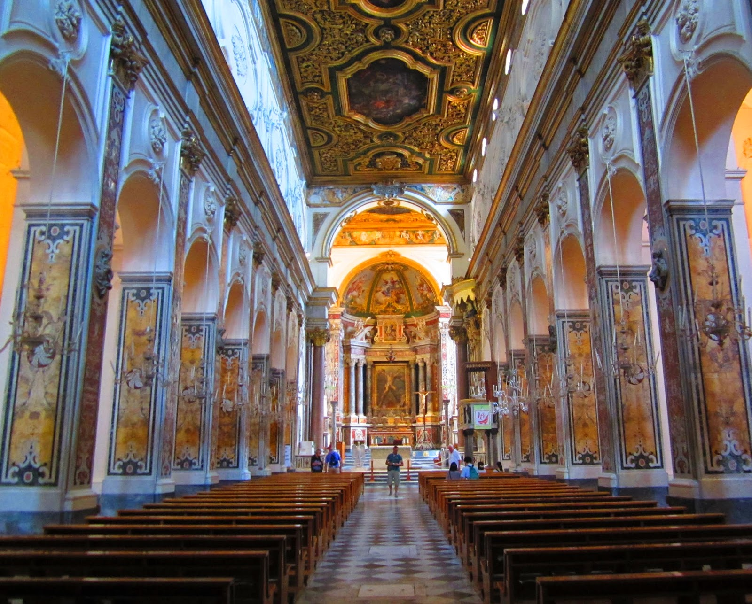
One of the most important and significant work of art of the church is the coffered ceiling dating back to the seventeenth century, of Angelo and Francesco Solimena and collaborators, where there are 21 paintings depicting episodes of the apparitions of St. Michael and other angels stretches from the ancient Testament, the new Testament and the Christian tradition.

Slide 11
THE END

